Slide 1
Selecting Talent
Session 4/10
Part I

Slide 2
Outline
The selection process
The main selection techniques
The selection interview procedure
Validity of selection procedures
Selection bias

Slide 3
Reflection
Have you recently applied for a job and went through the selection process?

Slide 4
Hiring in (poor) practice
“I can spend endless hours screening candidates and culling resumes that fit the criteria I have painstakingly developed with a client. And managers will still hire the person with the right “chemistry”, even if they don’t fit the criteria at all. They fall in love with a candidate and that’s it.”
Headhunter
What do you look for in a candidate? (Source: The Career Makers. Answers from some of the US top 150 recruiters)
“Intelligence and common sense”
“Presence, energy, vision, sense of humour”
“The first thing I look for is the degree to which a candidate is truly confortable with himself/herself”

Slide 5
Gut reactions to candidates often result in poor hiring decisions
(Note: This does not mean we should disregard a candidate’s character)
So what can we do to improve hiring?

Slide 6

Selection as Fit between the person and the job/organization
Define the position’s requirements as thoroughly as possible
Assess the candidate’s fit with those requirements
  Background Factors (Education, Experience, etc…)
  Personal Factors (intellectual ability, personality, motivation, etc.)

Slide 7
Background Factors
Education
  Is an educational background necessary or simply traditional practice? (eg, the requirement that university deans hold a Phd)
Experience
  Industry Experience – May be important to hire a Marketing VP(knowledge of products, key players in the market, costumers, etc…) but not a Controller (deals with internal processes)
  Functional Experience – Check tasks and responsibilities (titles can be misleading)
  Company Experience – Where did the candidate work? Some companies are known for breeding leaders and team players, others for developing paper pushers.

Slide 8
Personal Factors
Intellectual ability
  Analytical ability – Ability to take a complex problem, define it, break it down in pieces to understand it better and then put the pieces back together and come up with a solution
  Creative ability– This may encompass the ability to generate strategic options, come up with new product/service ideas, etc.
  Decision-making Style– Some people are extremely analytical, fact-based and structured. Others rely more on gut and intuition. Which style best fits the job/company?
Motivation (How much effort is the individual willing to make in his/her job?)
  Goals – Does the work fit with people’s own goals and ambitions?
  Interests - Does the work fit with people’s interests (a salesperson who does not like to talk to people is not likely to be successful) (see career orientations).

Slide 9
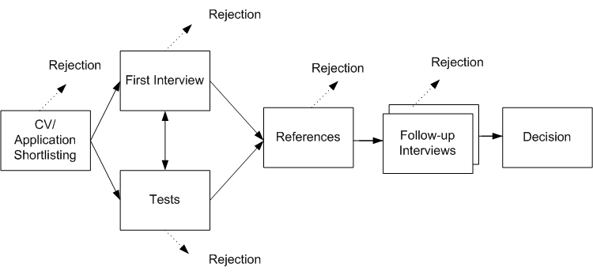
Selection Process
Shortlisting
Choosing selection techniques
Making the selection decision

Slide 10
Shortlisting
It’s the initial step in the selection process and aims to reduce the pool of applicants
It categorises applicants as “probable”, “possible” or “unsuitable”. Suitable candidates will proceed to the next stage
The criteria for shortlisting should be explicit

Slide 11
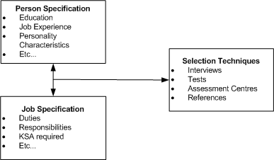
Deciding on Selection Techniques

Slide 12
Tests

Slide 13
Tests
Types of tests used for selection purposes:
Ability tests - Are concerned with skills and abilities already acquired by the candidate (e.g. typing tests)
Aptitude tests - Focus on individual’s potential to undertake specific tasks (e.g. verbal reasoning tests or numerical aptitude tests)
Intelligence tests – Give an indication of overall mental capacity
Personality questionnaires – Allow quantification of characteristics that are important to job performance.

Slide 14
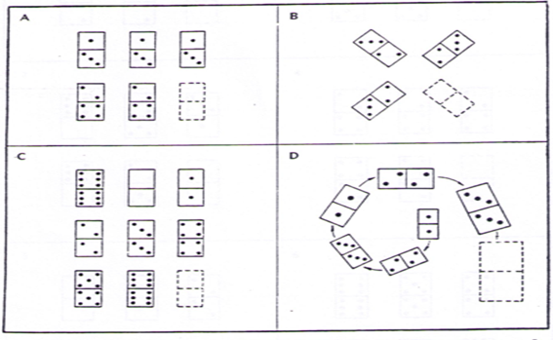
Example of a general intelligence test
What is the missing piece?

Slide 15
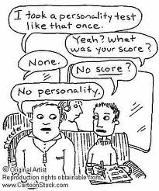
Personality
Personality
Enduring psychological characteristics which influence individual behavior in a distinct way (akin to character)
“He/she has no personality”
“He/She has a strong/weak personality”
These common expressions have no scientific meaning as everyone has personality characteristics

Slide 16
The Big 5 Personality Dimensions
HIGH ON | DIMENSION | LOW ON
Outgoing Enthusiastic Seeks novelty and excitement | Extraversion (positive affectivity) | Quiet Independent Enjoys time alone
Stress Worry Negative emotions | Neuroticism (negative affectivity) | Emotional stability
Organized/self-disciplined Scrupulous Self-directed | Conscientiousness | Spontaneous Careless
Trusting Empathetic | Agreeableness | Uncooperative Rude Suspicious of others
Creative Imaginative Eccentric Open to new experiences | Openness | Practical Conventional Rational

Slide 17
A few notes on Personality & Organizational Life
Conscientiousness - Often associated with Group Performance (Barrick & Mount, 1991) and OCB (Organ & Ryan, 1995)
Neuroticism – Associated with stress (Burke, Brief & George, 1993)
Extraversion – Associated with job satisfaction and subjective well-being (Diener, Sandvik, & Pavot, 1991) high performance in self-managed teams (Barry & Stewart, 2000)

Slide 18
Other Personality Models
Locus of Control
Self-Efficacy
Core self-evaluations

Slide 19
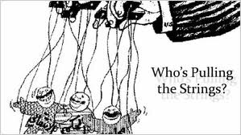
Locus of Control
The extent to which people believe that they are responsible for the events in their lives
  Internal Locus of Control – Belief that the events in one’s lives are the direct result of one’s actions (+motivated; +independent; +driven)
  External Locus of Control – Belief that the events in one’s lives are the result of other people’s actions or of random events

Slide 20
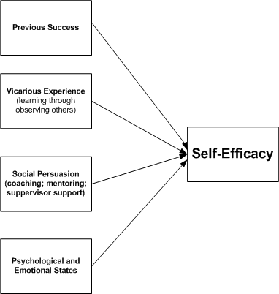

Self-Efficacy
It’s the belief that a behaviour will lead to a desired outcome (eg. Hard work will lead to promotion)

Slide 21
Core Self-evaluations
Captures the extent to which people have a positive sense of self.
A higher order trait capturing 4 meta-traits
  Locus of control
  Self-esteem
  General self-efficacy
  Neuroticism
Associated with higher job and life satisfaction and task performance

Slide 22
Study on the career success of recent graduates
  Final year undergraduate students at a London-based university who agreed to be followed as they entered the labour market
  3398 students were invited to participate
  Wave 1 (March 2015) – 796 (23.4%); 51.5% men, 82.9% single, 68.1% white, mean age 24.4 years
  Wave 2 (June 2016) – 400; 62% men, 72.9% single, 73.1% white, mean age 25.6 years

Slide 23
Measures
Core self-evaluations were measured with 12 items from Judge et al (2003). Sample items are “I am confident I get the success I deserve in life” and “When I try, I generally succeed”.
Employability was measured with 4 items from De Witte’s (Guest et al, 2010) perceived external employability measure. Sample items are “I am optimistic that I could find another job, if I looked for one” and “My qualifications and experience are in demand in the labour market”.
Social Capital was measured by adapting the measure developed by Seibert et al (2001). Respondents were asked to “think about the people you know who have acted to help your career by speaking on your behalf, providing you with information, or with whom you have regularly spoken regarding your career goals” and to indicate the number of such people and to indicate how close they were to each of them. We computed two dimensions of social capital - network size and strength of ties.
Boundaryless career orientation was measured with four items from Briscoe, Hall & DeMuth’s (2006) career mobility preference scale. Sample items are “I like the predictability that comes with working continuously for the same organization (R)” and “I would feel very lost if I couldn’t work for my current organization (R)”.
Protean career orientation was measured with four items from Briscoe et al.’s (2006) self-directed career management scale. Sample items are “Overall, I have a very independent, self-directed career” and “Ultimately, I depend upon myself to move my career forward”.

Slide 24
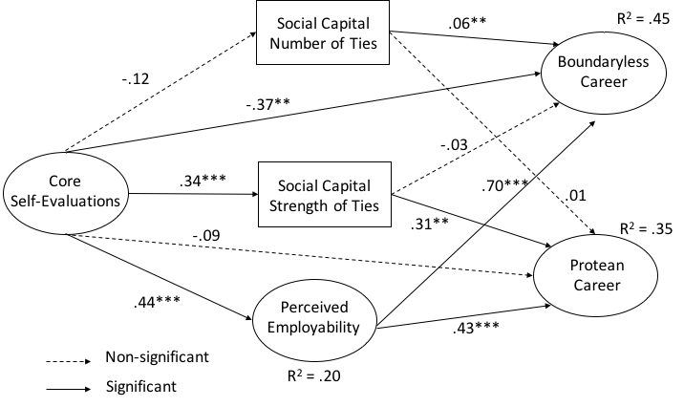
Some Findings [just to highlight the importance of personality]
CSE → (-) BC
SCNT → BC
PE → BC
SCST → PC
PE → PC
Models tested | χ² | df | χ² /df | CFI | TLI | SRMR | RMSEA
Measurement model | 609.42 | 252 | 2.42 | .82 | .80 | .10 | .06 (.05-.06)
Direct effects model | 332.76 | 221 | 1.51 | .94 | .93 | .07 | .04 (.03-.04)
Mediated model | 332.76 | 221 | 1.51 | .95 | .93 | .06 | .03 (.02-.04)

Slide 25
4 characteristics of a good test:
It is a sensitive measuring instrument which discriminates well between subjects
It has been standardized on a representative and sizeable sample of the population for which it is intended so that any individual’s score can be interpreted in relation to others
It is reliable in the sense that it always measures the same thing, i.e, a test aimed at measuring general intelligence should always measure the same characteristic when applied to different people or to the same person at different times
It is valid in the sense that it measures the characteristic which the test is intended to measure. An intelligence test should measure intelligence and not verbal ability

Slide 26
Activity
You can know more about yourself by doing the short form of the Big 5 personality questionnaire validated by Gosling et al (2003).
You can find the questionnaire attached to this vídeo with scoring instructions

